Slide 1
Let’s Talk Golf
By: Tommy Spurlock

Slide 2
Why Golf?
Golf's a Challenge: Tough but totally captivating
Pro Magic: Making the hard stuff look easy
Feeling Inspired: Pros push us to up our game
Learn from the Best: See what they do and why it works
Smart Improvement: Focus on what really matters to score better

Slide 3
Goals & Objectives
1. What is golf even about
2. Define golf terms and how we look at scoring
3. Look at four major phases of the game
Driving
Approach
Around the Green
Putting
4. Determine which phase plays the most into score on an individual hole.
5. So as an amateur where should I start?

Slide 4
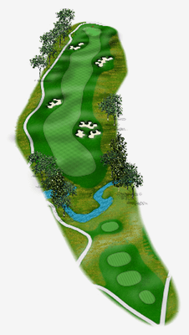
The Course
How Long is a Golf Course
The average golf course is approximately 6600 yards long, which is about 3.75 miles, and is made up of Par-3, 4 and 5’s, with a varying number of each depending on the course.
In general, there are between 3 to 4 Par-5’s (each measuring between 375-600 yds), anywhere from 6 to 14 Par-4’s (each between 240-490 yds) and about 3 to 4 Par-3’s (all should be under 250 yds).

Slide 5
Par for the Course
Scoring in golf is based on the number of strokes a player takes to complete each hole on a golf course. Here are the basic principles:
Strokes per Hole: Each hole on a golf course has a designated "par" score, which represents the number of strokes an expert golfer is expected to need to complete the hole. Par scores typically range from 3 to 5 strokes per hole, depending on the length and difficulty of the hole.
Counting Strokes: When playing, a golfer counts every stroke taken to hit the ball from the teeing area (where the hole begins) to the green and eventually into the hole. If a golfer misses the ball when attempting to strike it (a "whiff"), it still counts as a stroke.
Scoring Relative to Par:
Birdie: If a player completes a hole in one stroke less than par, it is called a birdie.
Par: Completing a hole in the exact number of strokes designated as par.
Bogey: If a player completes a hole in one stroke more than par, it is called a bogey.
Double Bogey, Triple Bogey, etc.: These terms refer to completing a hole two or three strokes over par, respectively.
Calculating Total Score: At the end of a round (typically 18 holes), a golfer adds up their total number of strokes. For example, if a player scores 72 strokes over 18 holes and the course par is 72, their score is even (par). If they score 70, they are 2 strokes under par, and if they score 74, they are 2 strokes over par.

Slide 6
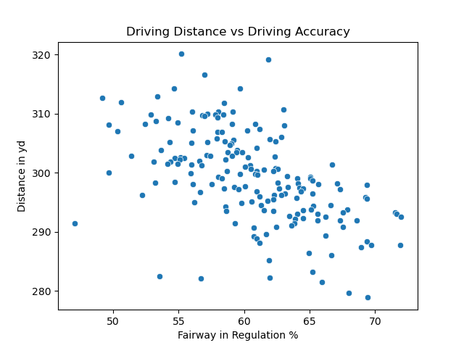
Driving and Thriving
Driving off the Tee Box Par 4/5
Driving Distance
Tour Mean: 298.9 yds
Tour Min: 279 yds
Fairway in Regulation
FIR Mean: 61%
FIR Min: 47%

Slide 7
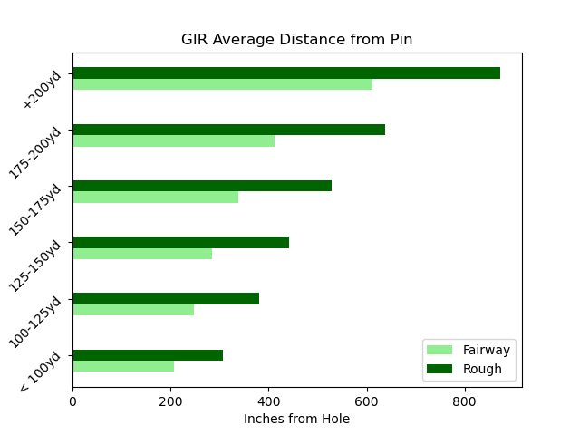
Thinking Green – The Approach
Green in Regulation
For all distances:
Tour Average: 66%
Tour Min: 60%
The percentage for greens hit vary with distance
Inside 100 yds Average: 86%
Around 150 yds Average: 66%
Outside 200 yds Average: 46%

Slide 8
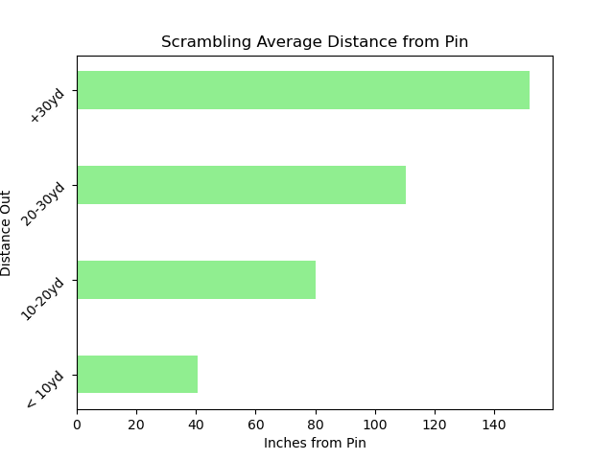
Okay… So I missed
So, what is scrambling?
Scrambling in golf is the ability to save par after missing the green in regulation.
For all distances :
Tour Avg: 59%
Tour Min: 50%

Slide 9
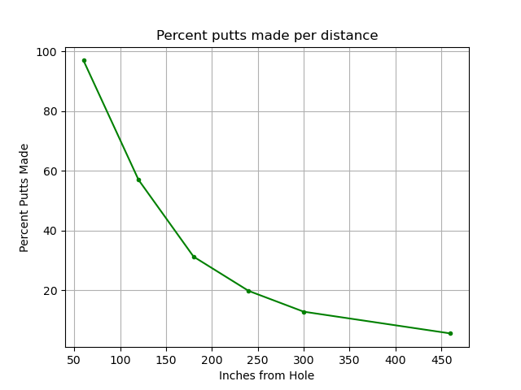
Get in the hole
Putting Avg per Distance
< 5 ft: 97%
5 -10 ft: 56%
10 – 15 ft: 31%
15 – 20 ft: 20%
20 – 25 ft: 13%
> 25 ft: 6%

Slide 10
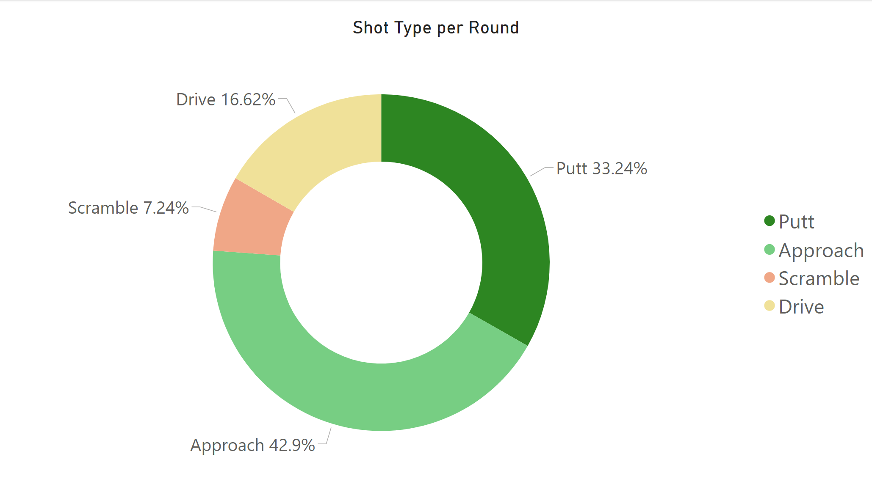
Putting it Together
Let’s breakdown club usage for a round

Slide 11




The Takeaway
Ranking our phases in order of importance for the amateur golfer.
Driving
Approach
Scrambling
Putting

Slide 12
The End

